Slide 1
Greenplum Workshop
Partitioning

Slide 2
Agenda
Why Partition a Table?
Difference between Partitioning and Distribution
Partitioning Guidelines
Loading Partitioned Tables

Slide 3
Partitions in Greenplum
Are a mechanism in Greenplum for use in physical database design
Increase the available options to improve the performance of a certain class of queries
Propagate data to the child tables
Partitioning in GP is different than in PostgreSQL
https://www.postgresql.org/docs/10/static/ddl-partitioning.html
https://www.postgresql.org/docs/9.1/static/ddl-partitioning.html
Notes:
Table partitioning is used to logically divide large tables to improve query performance and facilitate data warehouse maintenance tasks.
All structure of the parent table propagates to its children through table inheritance.
It is important to keep in mind that parent tables contain no data; all data is stored at the child table level.
If you create an index on the table, you will be implicitly creating an index on each of the child tables (the partitions).
It is also possible to create an index on the individual partitions.

Slide 4
Why Partition a Table?
To more efficiently query a subset of large data
Decrease query times by avoiding full table scans
To avoid the overhead and maintenance costs of an index
To handle increasing volumes of data that are not needed by the average query
Allow instantaneous dropping of older data and simple addition of newer data
Supports a rolling n period methodology for archiving data
Notes:
While Greenplum is not afraid of full table scans, it is a good idea to partition your table to help Greenplum process the table as efficiently as possible. However, your business rules should dictate if and how you partition tables.
The following are some of the reasons for considering table partition as part of the design:
Provide more efficiency in querying against a subset of large volumes of transactional detail data as well as to manage this data more effectively. Businesses have recognized the analytic value of detailed transactions and are storing larger and larger volumes of this data.
Increase query efficiency by avoiding full table scans.
Without the overhead and maintenance costs of an index for date.
As the retention volume of detailed transactions increases, the percent of transactions that the “average” query requires for execution decreases.
Allow the instantaneous dropping of old data and the simple addition of newer data that may be queried more often. One of the practical uses of partition tables is partition swapping or partition exchanging. This type of practice allows you to load data to a table and replace an existing table with the same data plus the updated information with little impact to the original table.
Support a rolling n periods methodology for transactional data.
You can have default partitions that act as a catchall. This allows you to insert rows without having to worry about a partition. Later, you can alter the table to split the partition with the values that you want to go to the partitioned table.

Slide 5

A Little More Detail
Reduces the amount of data to be scanned by reading only the relevant data needed to satisfy a query
The goal is to achieve partition elimination/pruning
Supports RANGE partitioning and LIST partitioning
Best practice - do not use multi level partitioning
Sub partitions often have little data or no data at all
Most queries cannot take advantage of partition pruning at the sub partition level.
Distribution allocates rows to segments. In each segment, partitioning separates the rows into distinct files.
Think of partitioned data in GP as a two dimensional separation of data, “plaiding”
Notes:
Table partitioning may be used to improve query performance by scanning only the relevant data needed to satisfy a given query. Table partitioning does not affect the physical distribution of data. GPDB supports both range partitioning or list partitioning. Range partitioning partitions the data based on a numerical range, for example by date, while list partitioning partitions the data based on a list of values, for example location (store, city, state, region). Partitioning using a combination of range partitioning and list partitioning is also supported. Table partitioning is implemented using table inheritance and constraints. Check constraints limit the data a table can contain based on some defining criteria. These constraints are also used at runtime to determine which child tables to scan in order to satisfy a given query.

Slide 6



Historical Data Management
Rolling 13 months
Months older than 13 months cycles to the next stage
Recent month
Jan 2010
Feb 2010
Mar 2010
Feb 2011
Apr 2010
Jan 2000 –
Dec 2009
May 2010
Jun 2010
Jul 2010
Aug 2010
Sep 2010
Deep history
Oct 2010
(this can be HDFS or s3 or plain old files)
When a new month starts, current month cycles to next stage
Nov 2010
Dec 2010
Jan 2011
Notes:
Let’s begin by considering how table partitioning, combined with a couple of other GPDB storage features, provides a powerful Information Lifecycle Management, or “ILM”, solution. This example shows a large, partitioned, fact table, tracking transactions back to January 2000. The current month is “live”, and its data is stored in a row-oriented partition, which is defined on a tablespace which links to an SSD-based filespace. Queries against this partition are extremely reponsive, and may include INSERT, UPDATE, and DELETE, in addition to SELECT. The previous month’s data, along with data going back on year, is housed within Append-Optimized, columnar partitions, defined within a tablespace tied to SAS disks. This portion of the data is optimized for the type of reports the organization needs to run against data for the past year. Older, “deep history” data, is stored on an adjacent Hadoop cluster, within a partition defined as an external table, using the “gphdfs” protocol. When a query’s date range includes endpoints spanning any of these time periods, the relevant data is automatically scanned.
This is the power available through table partitioning.

Slide 7
Table Partitioning Overview
Address challenges in supporting very large tables
Divide data into smaller, more manageable pieces
Can improve query performance
Can facilitate database maintenance tasks
Utilizes inheritance and constraints
Distributes data across segments (as usual)
Notes:
Table partitioning:
Addresses the problem of supporting very large tables, such as fact tables, by allowing you to divide them into smaller and more manageable pieces.
Can improve query performance by scanning only the relevant data needed to satisfy a given query. Data is eliminated either during the planning phase or at runtime. This helps to reduce the number of rows returned for joins and further actions.
Can be used to facilitate database maintenance tasks such as rolling old data out of the data warehouse or speeding up the update of indexes.
Works using table inheritance and constraints. Table inheritance creates a persistent relationship between a child table and its parent table(s), so that all of the schema information from the parent table propagates to its children. CHECK constraints limit the data a table can contain based on some defining criteria. These constraints are also used at runtime to determine which tables to scan in order to satisfy a given query.
In Greenplum Database, partitioned tables are distributed across the segments as is any non-partitioned table. Partitioning is the method of logically dividing big tables to improve query performance and maintenance. It distinct from the DISTRIBUTED BY clause.

Slide 8


Supported Table Partitioning Methods
Range Partitioning
List Partitioning
JAN 2010
JAN 2010
FEB 2010
FEB 2010
EMEA
MAR 2010
EMEA
MAR 2010
APAC
APAC
APR 2010
APR 2010
AMER
AMER
Notes:
Greenplum Database supports:
Range partitioning, where the data used for partitioning is based on a numerical range, such as date or price.
List partitioning, where data used for partitioning is based on a list of values, such as a region.
A combination of range and list partitioning.

Slide 9
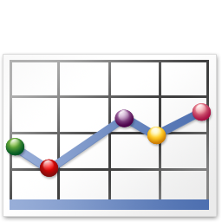
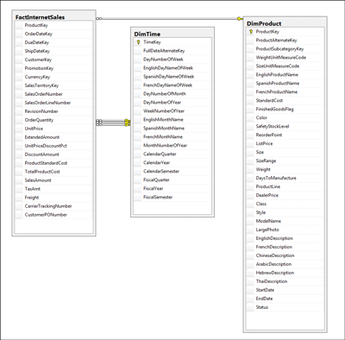

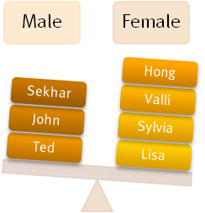
When Do You Partition?
When you have a large fact table
Experiencing unsatisfactory performance
You have identifiable access patterns
Jan 2010
Dec 2009
Feb 2010
Mar 2010
Feb 2011
Apr 2010
May 2010
Jun 2010
Jul 2010
Aug 2010
Sep 2010
Oct 2010
Nov 2010
Dec 2010
Jan 2011
You need to maintain rolling data
Data can be divided into equal parts based on a column
Notes:
There are several reasons why you would partition your data:
Large fact table – Large fact tables are good candidates for table partitioning. If you have billions of rows in a table, you will see performance benefits from breaking that data up into smaller chunks. For smaller tables, avoid partitioning.
Unsatisfactory performance – As with any performance tuning initiative, a table should be partitioned only if queries against that table are producing slower response times than desired.
Identifiable access patterns – Examine the WHERE clauses of your query workload and look for table columns that are consistently used to access data. For example, if most of your queries look up records by date, then date range based partitioning design might be beneficial.
Maintaining rolling data – as discussed earlier, partitioning provides great ILM benefits.
Dividing data into equal parts – Choose a partitioning criteria that will divide your data as evenly as possible. For example, by dividing a large table into 10 partitions of equal size, you should see a 10x speedup for queres having predicates which restrict them to scanning a single partition.

Slide 10
Creating Partitioned Tables
A table …
Can be partitioned only at creation time
Can be partitioned with the command, CREATE TABLE
Can be subpartitioned into additional levels
But don’t overpartition
Can be partitioned using the following partition designs:
Date range
Numeric range
List
Notes:
A table can only be partitioned at creation time using the CREATE TABLE command.
The first step in partitioning a table is to decide on the partition design (date range, numeric range, or list of values) and choose the column on which to partition the table.
You can partition a table using:
A date range
A numeric range
A list

Slide 11
Creating a Range Partitioned Table
Use CREATE TABLE to create partitioned tables.
CREATE TABLE sales (id int, date date, amt decimal(10,2))
DISTRIBUTED BY (id)
PARTITION BY RANGE (date)
( PARTITION Jan18 START (date '2018-01-01') INCLUSIVE ,
PARTITION Feb18 START (date '2018-02-01') INCLUSIVE ,
PARTITION Mar18 START (date '2018-03-01') INCLUSIVE ,
…
PARTITION Dec18 START (date '2018-12-01') INCLUSIVE
END (date '2019-01-01') EXCLUSIVE );
Notes:
You can define a date range or a numeric range for a partitioned table:
A date range uses a single date or timestamp column as the partition key column.
When date partitioning a table, consider partitioning by the most granular level you are interested in. For example, partition by day and have 365 daily partitions, rather than partitioning by year, then subpartitioning by month, then subpartitioning by day.
You can have Greenplum Database automatically generate partitions by giving a START value, an END value, and an EVERY clause that defines the partition increment value. By default, START values are always inclusive and END values are always exclusive. Note: You can declare and name each partition individually.

Slide 12
Creating a Range Partitioned Table (Cont’d.)
Use CREATE TABLE to create partitioned tables.
CREATE TABLE ranking (id int, rank int, year int, gender char(1), count int)
DISTRIBUTED BY (id)
PARTITION BY RANGE (year)
( START (2011) END (2021) EVERY (1),
DEFAULT PARTITION extra );
Caveat: avoid using DEFAULT PARTITION, because it is always scanned, and in certain cases can contain far more data than expected.
Contrary Opinion: The default partition is good for catching bad values. If it has lots of data in it, maybe you should be rethinking about your data ingest and data maintenance processes.
Notes:
A numeric range uses a single numeric data type column as the partition key column
Caveat: avoid using DEFAULT PARTITION, because it is always scanned, and in certain cases can contain far more data than expected.

Slide 13
Creating a List Partitioned Table
Use CREATE TABLE to create partitioned tables.
CREATE TABLE thingies (id int, rank int, year int, state char(2))
DISTRIBUTED BY (id)
PARTITION BY LIST (state)
( PARTITION NewEngland VALUES ('ME','NH','VT','MA','RI',’CT’),
PARTITION MidLantic VALUES ('NY','NJ','PA','DE','MD','DC')
…
PARTITION WestCoast VALUES ('CA','OR','WA','AK','HI') ,
DEFAULT PARTITION other );
Caveat: avoid using DEFAULT PARTITION, because it is always scanned, and in certain cases can contain far more data than expected.
Contrary Opinion: The default partition is good for catching bad values. If it has lots of data in it, maybe you should be rethinking about your data ingest and data maintenance processes.
Notes:
You can define a date range or a numeric range for a partitioned table:
A date range uses a single date or timestamp column as the partition key column.
When date partitioning a table, consider partitioning by the most granular level you are interested in. For example, partition by day and have 365 daily partitions, rather than partitioning by year, then subpartitioning by month, then subpartitioning by day.
You can have Greenplum Database automatically generate partitions by giving a START value, an END value, and an EVERY clause that defines the partition increment value. By default, START values are always inclusive and END values are always exclusive. Note: You can declare and name each partition individually.

Slide 14
Partitioning an Existing Table
When working with an existing table:
You cannot partition the table once it’s been created
You can create a new partitioned table and migrate your data
Notes:
It is not possible to partition a table that has already been created. Tables can only be partitioned at CREATE TABLE time.
To partition an existing table, you must:
Recreate the table as a partitioned table.
Reload the data into the newly partitioned table.
Drop the original table and rename the partitioned table to the original name.
Grant any table permissions to the new table that were granted on the original table.

Slide 15
Partitioning an Existing Table (Cont’d.)
CREATE TABLE sales2 (LIKE sales)
PARTITION BY RANGE (date)
( START (date '2008-01-01') INCLUSIVE
END (date '2009-01-01') EXCLUSIVE
EVERY (INTERVAL '1 month') );
INSERT INTO sales2 SELECT * FROM sales;
DROP TABLE sales;
ALTER TABLE sales2 RENAME TO sales;
GRANT ALL PRIVILEGES ON sales TO admin;
GRANT SELECT ON sales TO guest;

Slide 16
Partition Maintenance
Add, rename, truncate, remove a partition
Exchange a partition
CREATE TABLE jan18 (LIKE sales) WITH (appendonly=true);
INSERT INTO jan18 SELECT * FROM sales_1_prt_1 ;
ALTER TABLE sales EXCHANGE PARTITION FOR ('2018-01-01') WITH TABLE jan08;
Split an existing partition
ALTER TABLE sales SPLIT PARTITION FOR ('2008-01-01')
AT ('2008-01-16')
INTO (PARTITION jan081to15, PARTITION jan0816to31);

Slide 17
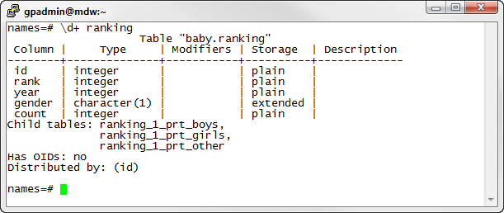
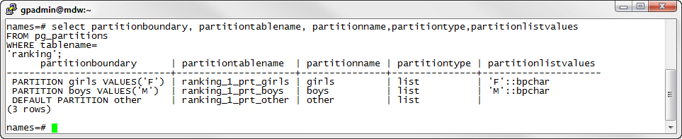
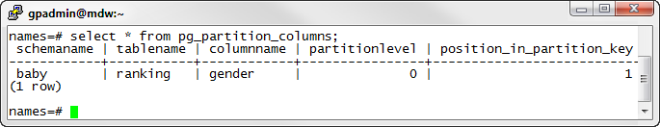
Viewing Details on Partitioned Tables
Details on the parent and child tables
pg_partitions view lets you obtain more details on partitioned tables
pg_partition_columns displays the column used for partitioning
Notes:
Some partition information can be obtained by using the \d+ PSQL meta-command. All child tables are displayed by their names.
You can obtain additional information from the pg_partitions view.
The pg_partition_columns view displays the column used for partitioning.

Slide 18
Loading Partitioned Tables
Top-level parent tables are empty
Data is loaded into child partitions
COPY or INSERT automatically loads data to the correct partition
Load a staging table and swap the table in place of an existing partition
ALTER TABLE … EXCHANGE PARTITION
Notes:
With partitioned table structure, top-level parent tables are empty. Data is routed to the bottom-level child table partitions. COPY or INSERT automatically loads to the correct partition. Best practice for loading data into partitioned tables is to create an intermediate staging table, load it, and then exchange it into your partition table. You can exchange partitions only at the lowest level of your partition hierarchy. Rows that cannot be mapped to a child table partition are rejected and the load fails. To avoid unmapped rows being rejected at load time, define your partition hierarchy with a DEFAULT partition. Any rows that do not match a partition’s CHECK constraints load into the DEFAULT partition.
The DEFAULT partition is always scanned and can slow down the overall scan time.

Slide 19
Partitioning Guidelines
Never distribute and partition on the same column!
Do not use multi-level partitioning (i.e. sub-partitions). Multi-level partitioning typically applies to edge cases only.
Use table partitioning on large tables to improve query performance
Table partitioning is not a substitute for distributions
Use if the table can be divided into rather equal parts based on a defining criteria
For example, RANGE partitioning on date
No overlapping ranges or duplicate values
And the defining partitioning criteria is the same access pattern used in query predicates
Do not use DEFAULT partition as it is always scanned and can grow rather large in size
Notes:
Use for very large tables, such as fact tables, to improve query performance. For smaller tables the administrative overhead of maintaining the partitions will outweigh any performance benefits you might see. The primary goal of table partitioning is to eliminate scanning partitions that contain data that is not needed to satisfy a query. Consider table partitioning on large tables that can be divided into somewhat equal parts based on a defining criteria and the defining criteria is used in query predicates. If the query access pattern (SELECT….WHERE) does not match the partitioning definition the benefit of partition elimination is not achieved.
When defining partitioning criteria it is important to not have overlapping ranges if using range partitioning and to ensure list values are unique if using list partitioning.

